Slide 1
From Collision to Consequence
47
years of crash data
Factors affecting injury severity in road crashes
Group 36: Pradeep Khoushal, Veena Sureshkumar Harishankar
Notes:
Hari and Pradeep, 0:00, 15 seconds
Hi, I'm Hari. And I'm Pradeep. We're Group 36, and this is From Collision to Consequence. When someone is hurt in a road crash, why do some walk away with a bruise, while others are killed or seriously injured?

Slide 2
Dataset Overview
47
12.1M
9.1M
653k
years, 1979–2025
casualties
collisions
casualties in 2021–25, used for the detail
What it is
How we read it
STATS19: every road crash with an injury reported to police in Great Britain, published by the Department for Transport.
Three linked tables: collisions, vehicles and casualties.
Not included: unreported crashes and traffic volumes, so we compare severity once hurt, not risk per mile.
KSI: killed or seriously injured, shown per 1,000 casualties.
Exposed: pedestrians, cyclists and motorcyclists. Solid lines, circles.
Protected: people inside a vehicle. Dashed lines, squares.
Source: Department for Transport, road casualty statistics (STATS19), 1979 to latest published year.
Notes:
Hari, 0:15, 27 seconds
Our data is STATS19, the official police record of road crashes in Great Britain where someone was hurt. It covers 47 years and over 12 million casualties, and we use the last five years for detail. It can't show how likely you are to crash, so we compare how badly people are hurt. KSI means killed or seriously injured. Exposed means pedestrians, cyclists and motorcyclists. Protected means people inside a vehicle.

Slide 3
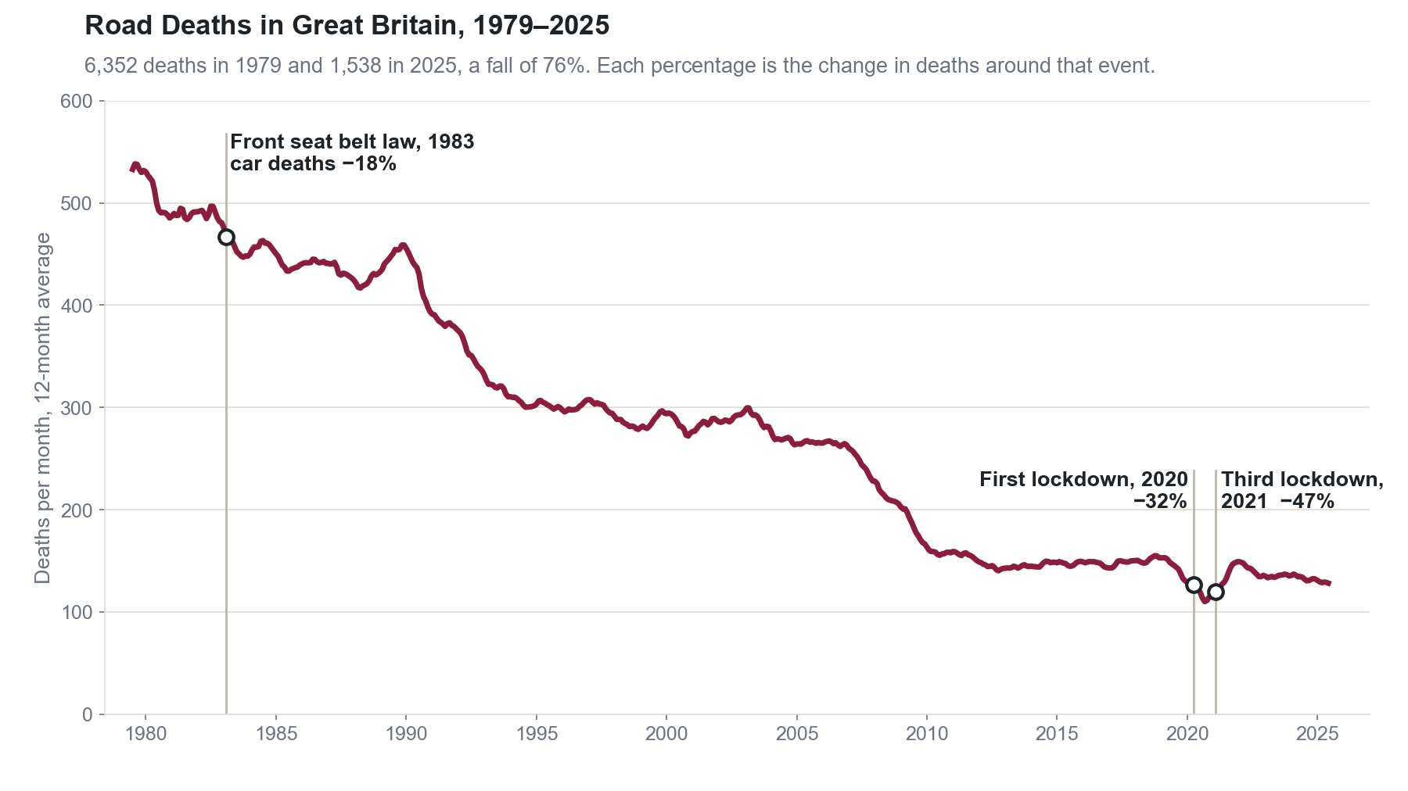
Notes:
Hari, 0:42, 24 seconds
In 1979, over 6,300 people died on Britain's roads. In 2025, it was about 1,500. That's 76% fewer deaths, and you can see the seat belt law and COVID in the line. It looks like a success story. But this is one average line. So who does it really describe?

Slide 4
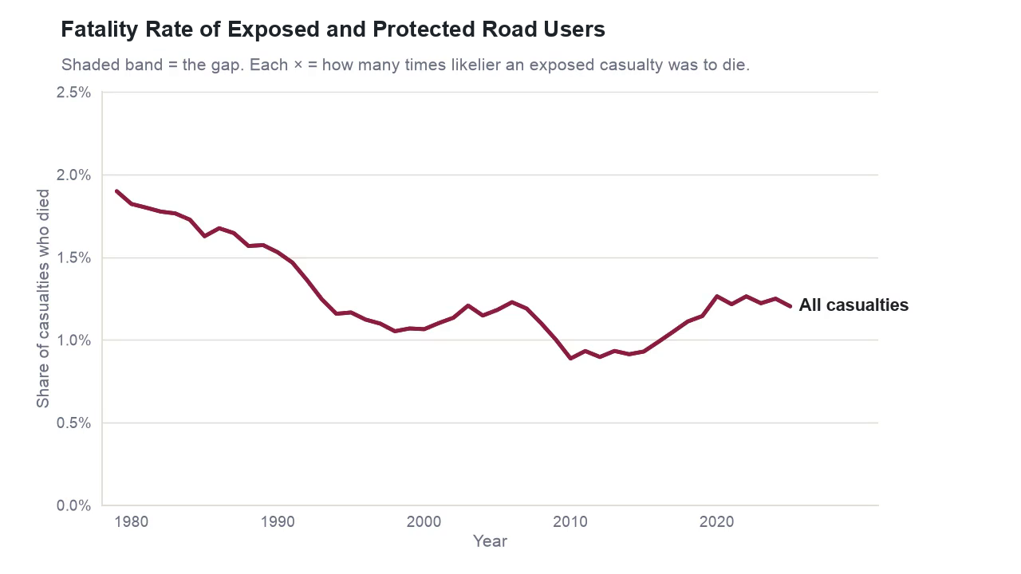
Notes:
Hari, 1:06, 36 seconds
This line shows the share of people hurt who died. Now we split it in two: red for exposed, blue for protected. Both lines fall, so both groups got safer. But look at the gap between them. In 1979, an exposed casualty was one and a half times as likely to die. By 2010, it was 2.35 times, the widest gap on record. Today it's 1.7 times, still wider than in 1979. So the good news never fully reached the people with the least protection.

Slide 5
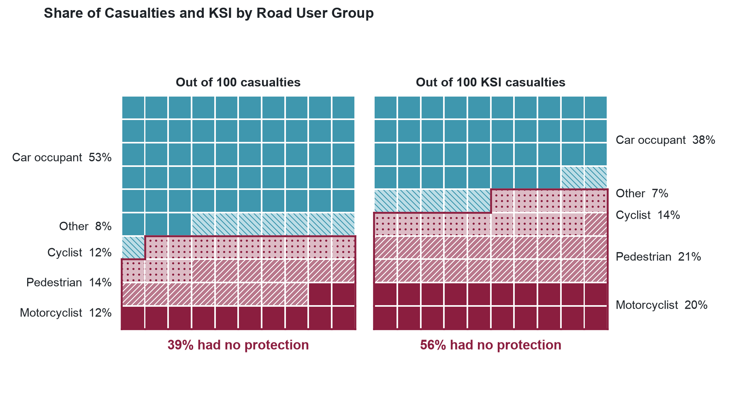
Notes:
Hari, 1:42, 20 seconds
So why is there a gap? We now use the last five years. Each square is 1 in 100 people. Among everyone hurt, exposed road users are 39%. Among those killed or seriously injured, they're 56%. They're much more likely to end up in the worst group.

Slide 6
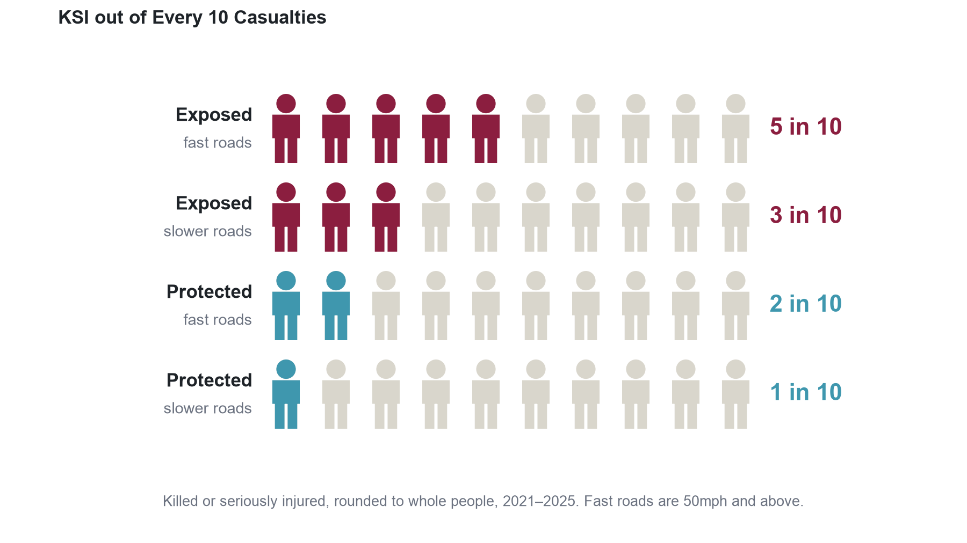
Notes:
Hari, 2:02, 25 seconds
Are exposed people just on more dangerous roads? Each row here is 10 people who were hurt, and the coloured ones were killed or seriously injured. Fast roads make things worse for both groups. But compare the middle two rows. Exposed on a slower road: about 3 in 10. Protected on a fast road: about 2 in 10. So the road matters, but protection matters more.

Slide 7
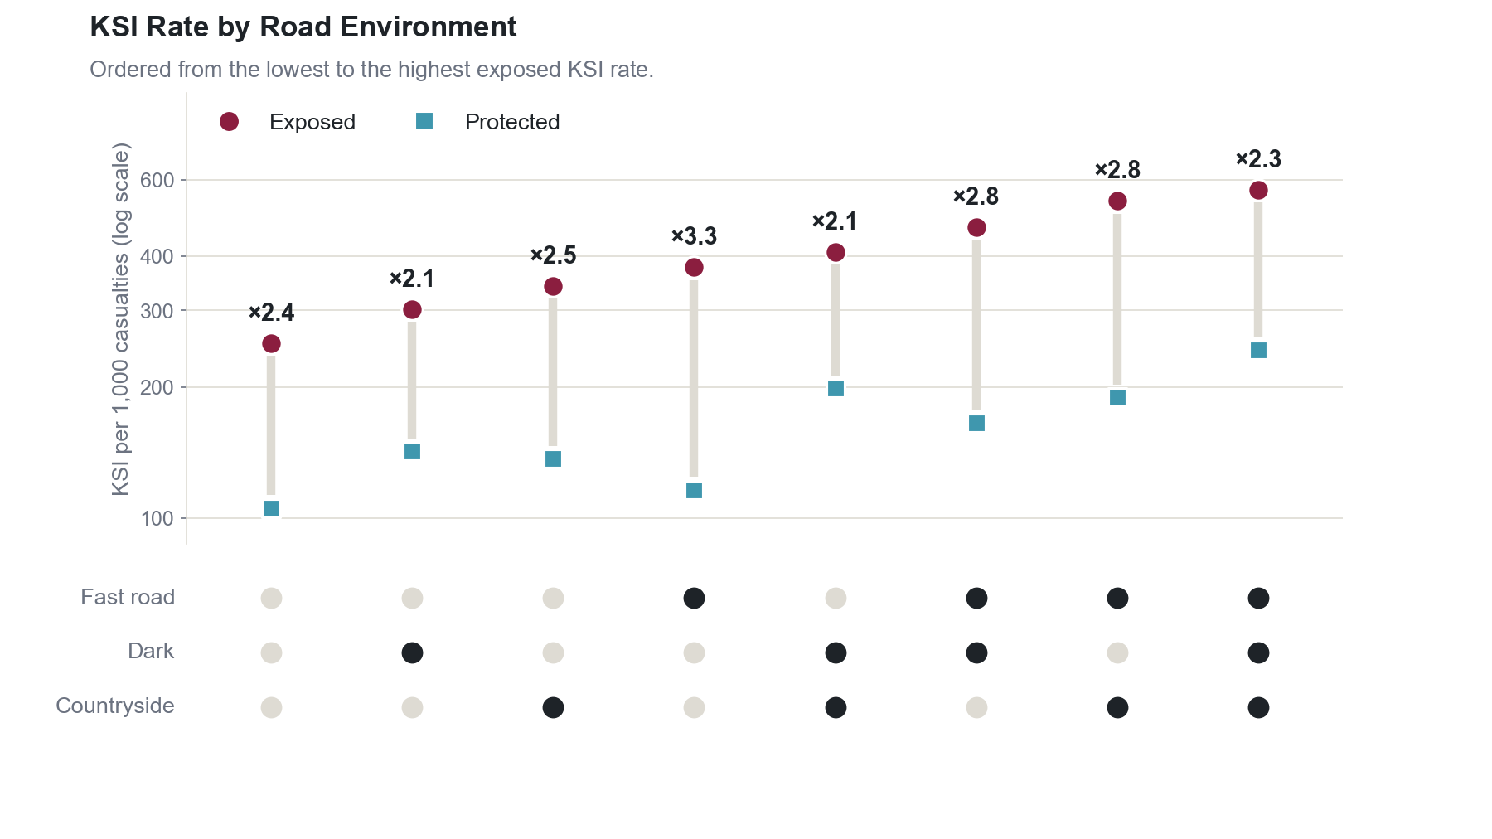
Notes:
Hari, 2:27, 25 seconds
To be sure, we compared both groups in the same conditions. Each column is a type of road, and the black dots show its risks: fast, dark, or countryside. The number on top shows how many times worse exposed people do. It's at least 2.1 times every time. So it isn't the road. It's the lack of protection. But what happens when risks combine?

Slide 8
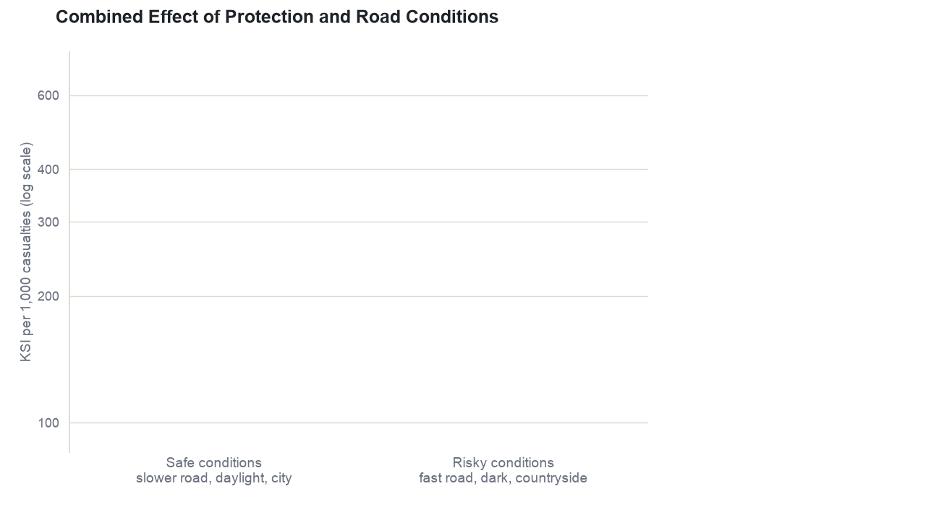
Notes:
Pradeep, 2:52, 38 seconds
I'm Pradeep. Here are four real situations. The safest is a protected person on a slow city road in daylight: 105 out of 1,000 are KSI. Take away the protection, and it's 252. Keep the protection, but move to a fast, dark country road, and it's 244. Each risk alone more than doubles it. So what if both happen together? If risks added up, we'd expect about 390. If they multiplied, about 582. The real number is 569. Risks don't add. They multiply.

Slide 9
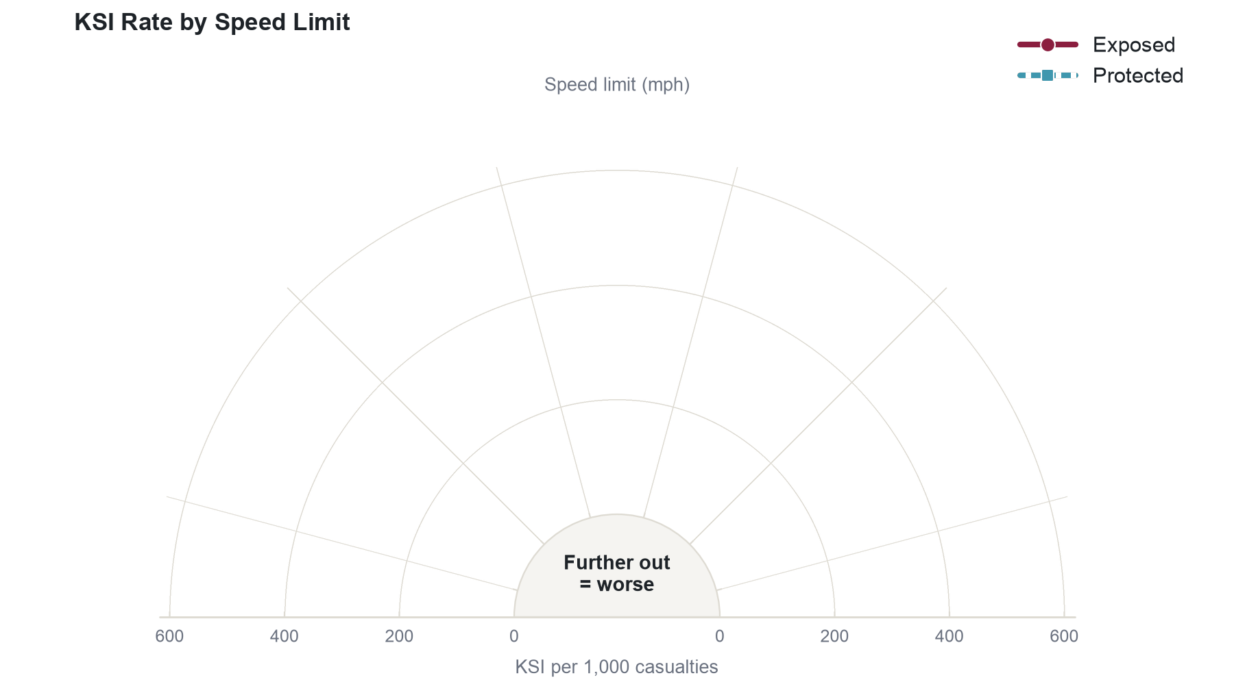
Notes:
Pradeep, 3:30, 23 seconds
Speed limits show the same idea. Each spoke is a speed limit, and further out is worse. For exposed people, the rate climbs at every step. For protected people, it climbs too, but stays much lower. Then at 70, on motorways, it drops from 227 to 162. A motorway only helps people who are already protected.

Slide 10
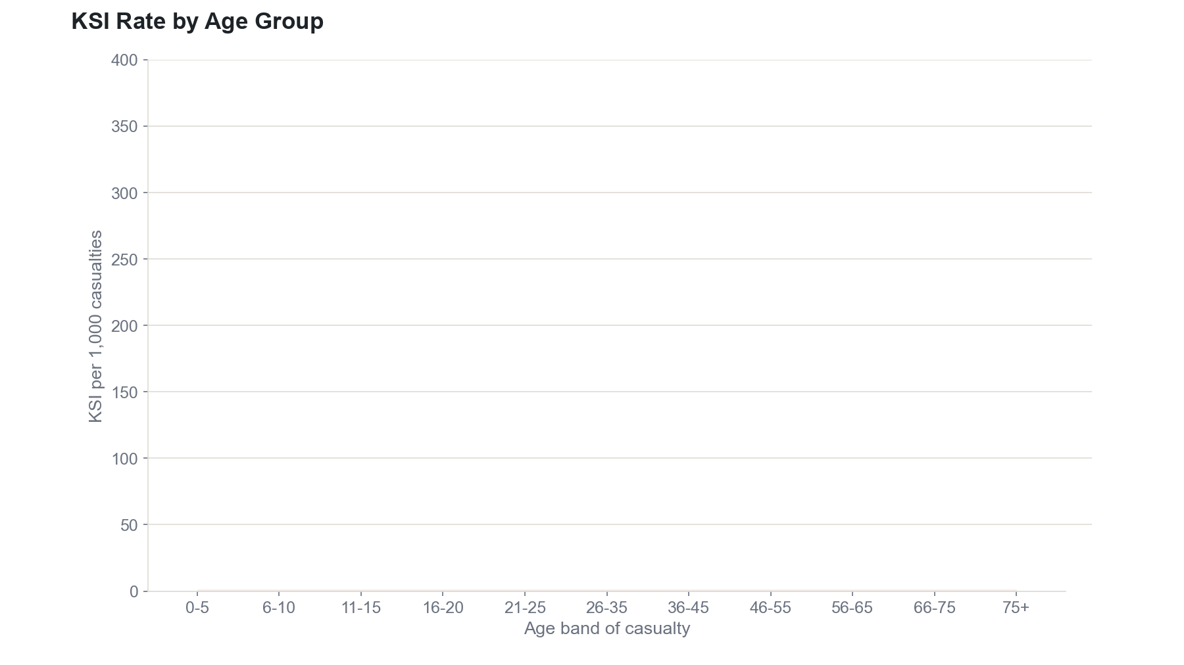
Notes:
Pradeep, 3:53, 20 seconds
Age tells a similar story. Young children have the lowest rate, 160. It rises to 231 for teenagers, then dips for adults, likely because they drive more carefully. After that, it climbs steadily, to 336 for people over 75, whose bodies are more fragile.

Slide 11
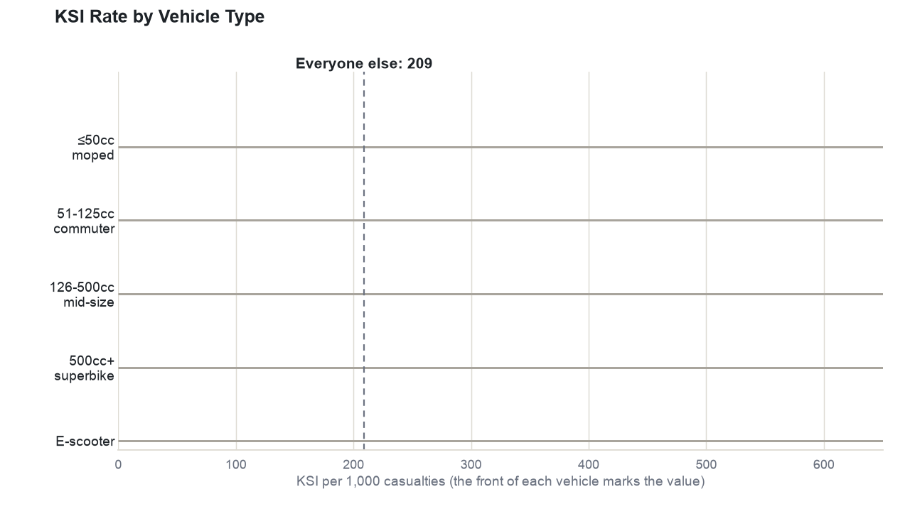
Notes:
Pradeep, 4:13, 19 seconds
Exposed road users aren't all the same. The dashed line is everyone else, at 209. On the biggest motorbikes, it's 517: more than half of those hurt are killed or seriously injured. E-scooter riders, at 309, are 48% above everyone else.
Icon credits (not narrated): moped and 126-500cc, Phosphor Icons, MIT, Copyright Phosphor Icons. Commuter, Health Icons, CC0. Superbike and e-scooter, Microsoft Fluent Emoji, MIT, Copyright Microsoft Corporation. Recoloured, some mirrored.

Slide 12
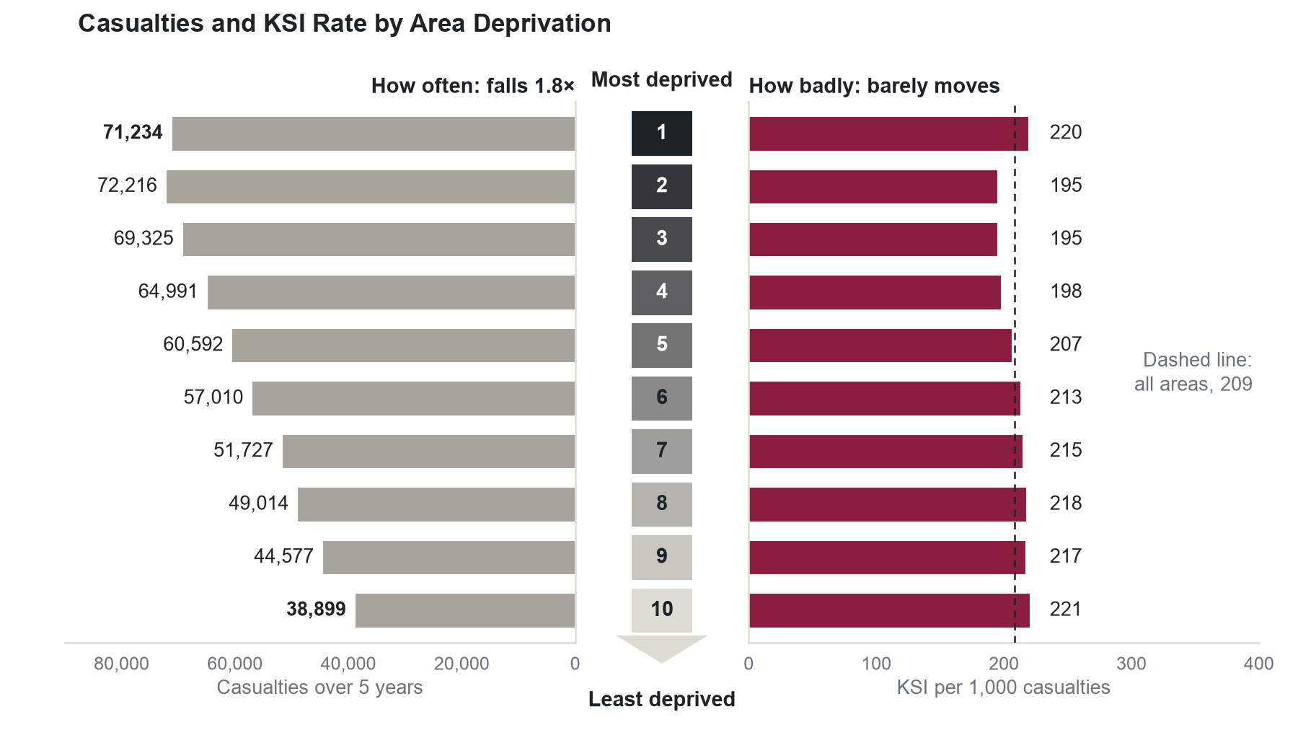
Notes:
Pradeep, 4:32, 18 seconds
Next, deprivation, which means how poor an area is. On the left, casualties fall steadily, so the most deprived areas have nearly twice as many as the least. On the right, the KSI rate barely moves. People from poorer areas aren't hurt worse. They're hurt more often.

Slide 13
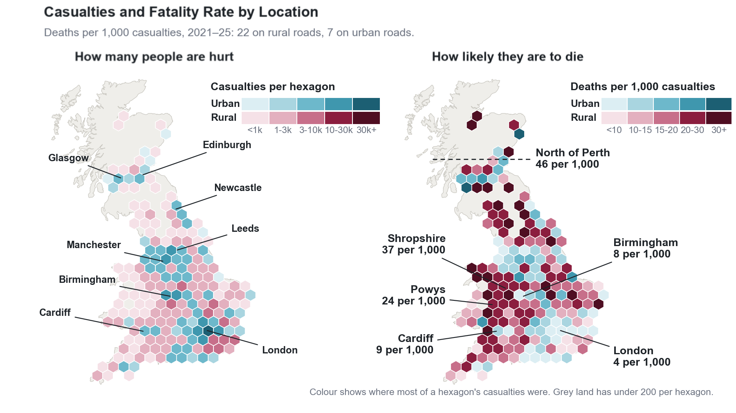
Notes:
Pradeep, 4:50, 22 seconds
Blue areas are mostly urban, red mostly rural. On the left, you can see people get hurt mostly in cities. On the right, you can see they're more likely to die on rural roads. North of Perth, 46 out of 1,000 casualties die. In London, it's 4. Shropshire and Powys show the same thing.

Slide 14
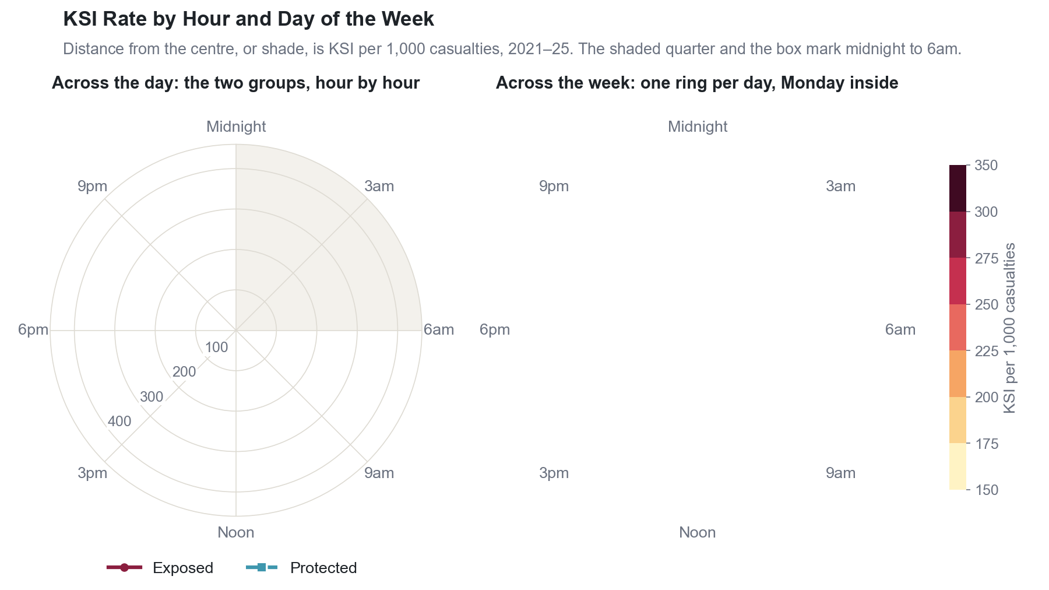
Notes:
Pradeep, 5:12, 15 seconds
Time of day matters too. On the left, further out is worse, and both groups are at their worst overnight. On the right, each ring is a day of the week. The darkest area sits around midnight, every day.

Slide 15
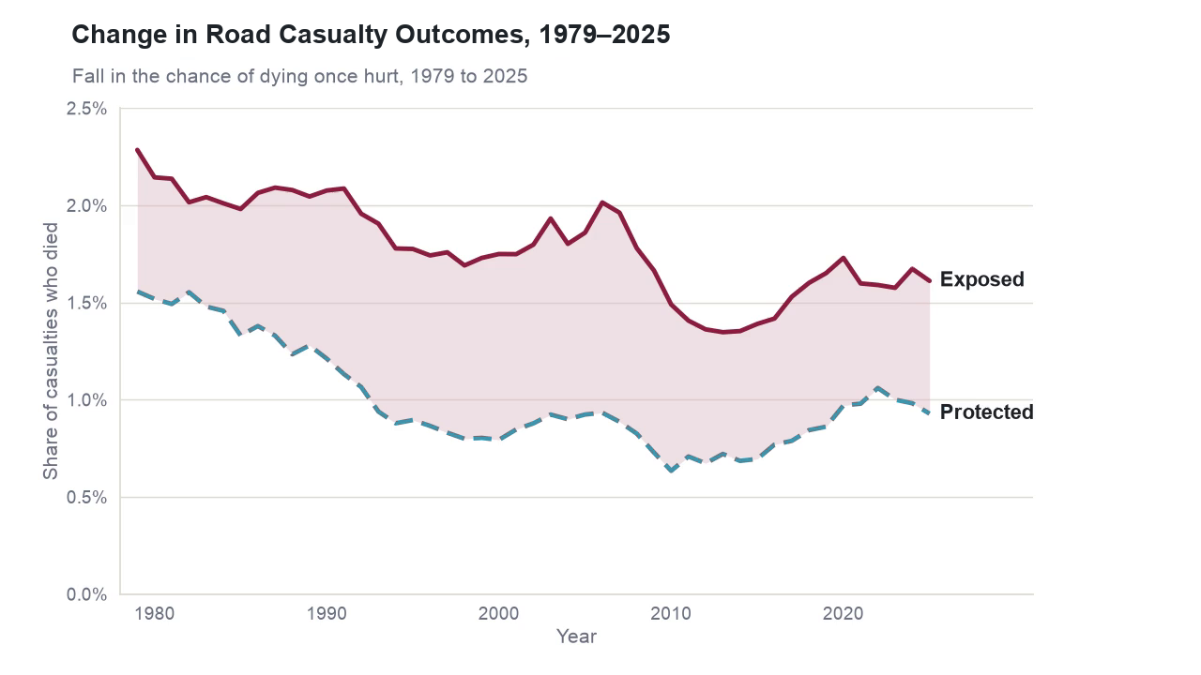
Notes:
Pradeep, 5:27, 25 seconds
Back to where we started. Once hurt, the chance of dying fell 40% for protected road users, but only 29% for exposed ones. Put them back together, and you get the average line, and the 76% fall in deaths is real. Road safety worked, but it didn't reach everyone equally. And the worst outcomes come when risks multiply. Thank you for watching.

Slide 16
Conclusion
76%
fewer deaths
From Collision to Consequence
Group 36: Pradeep Khoushal, Veena Sureshkumar Harishankar
Notes:
Pradeep, 5:52. Hold for 3 seconds, then end the recording.

